Slide 1
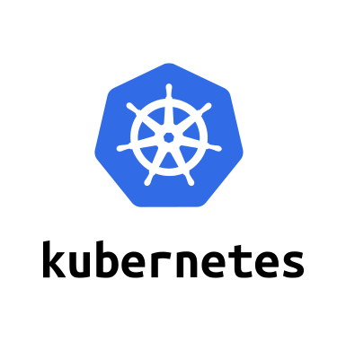
Getting Started with Kubernetes

Slide 2
Agenda
Setting up your Minikube environment
Kubernetes Architecture/ICP
A closer look at Kubernetes cluster
Master components
Node components
Pods
Labels & Selectors
Replication Controllers
Services
Kubernetes/ICP A Closer Look at Pods and Replicas
Understand the concept of Pods
Explore multi-container Pods
Closer look at the use cases and scenarios for multi-container pods
Scaling Pods through Replica Sets

Slide 3
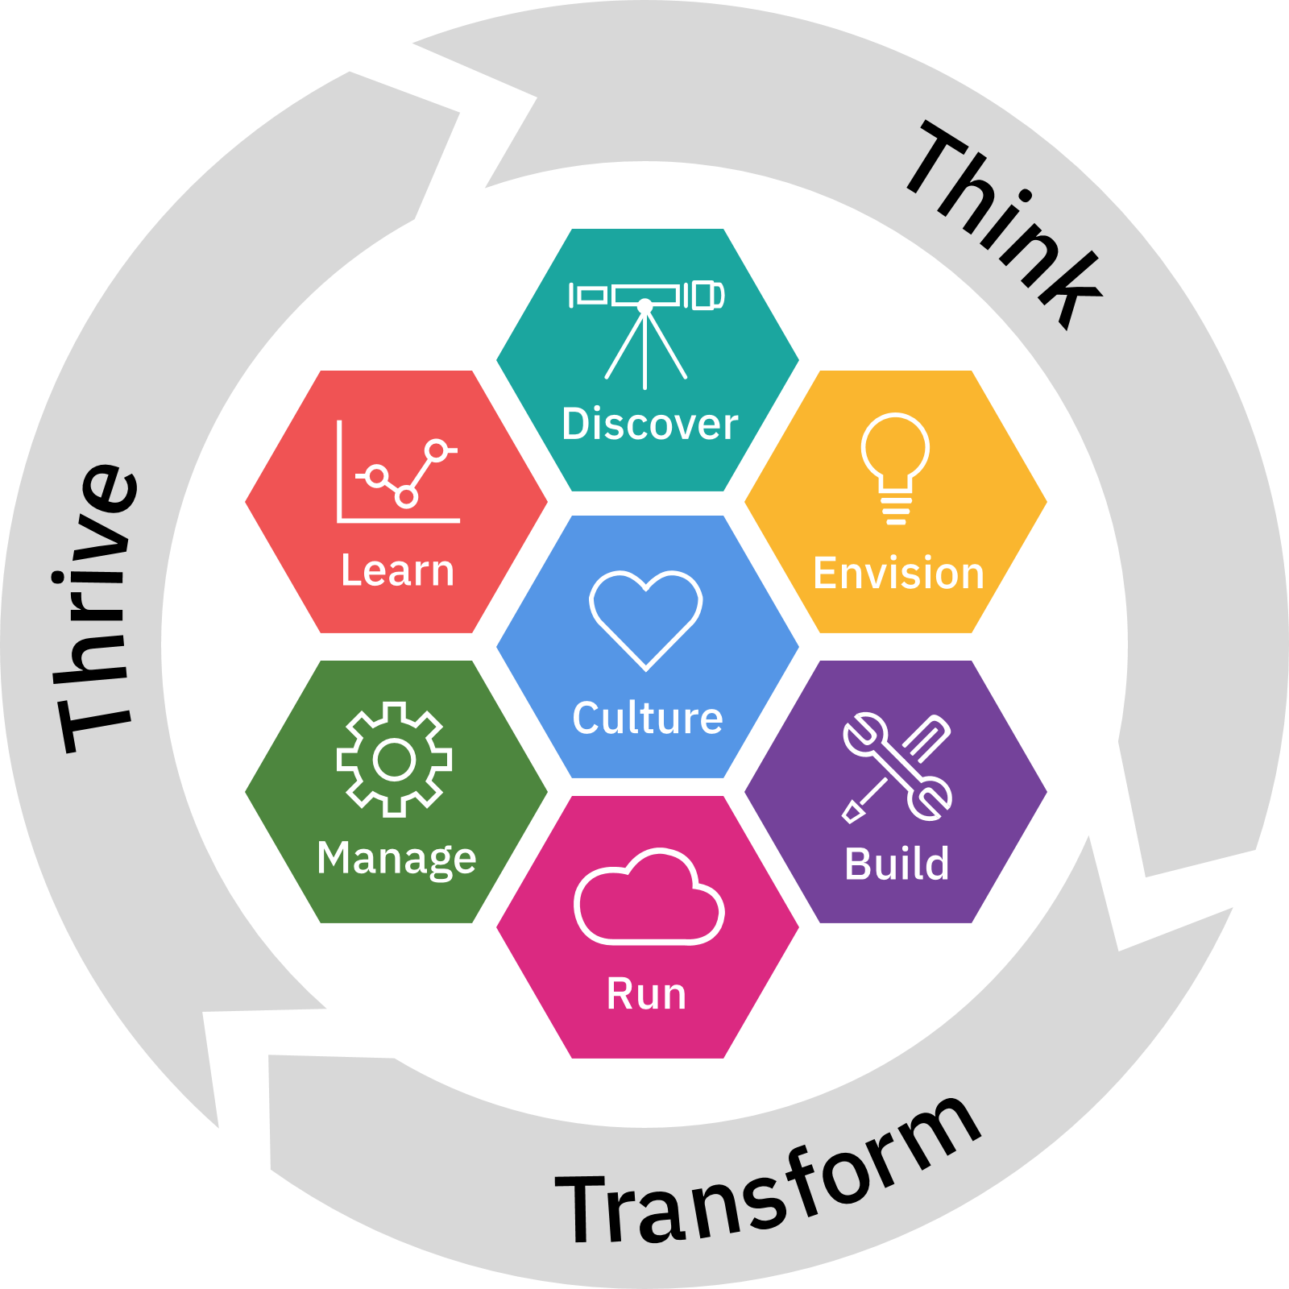
IBM Cloud Garage
This talk is sponsored by the Garage.
Benefit from combining IBM Design Thinking, Lean Startup, agile development and continuous delivery to build scalable, innovative solutions.
https://www.ibm.com/cloud/garage/
Garage
Method
Architectures
Courses
Services

Slide 4
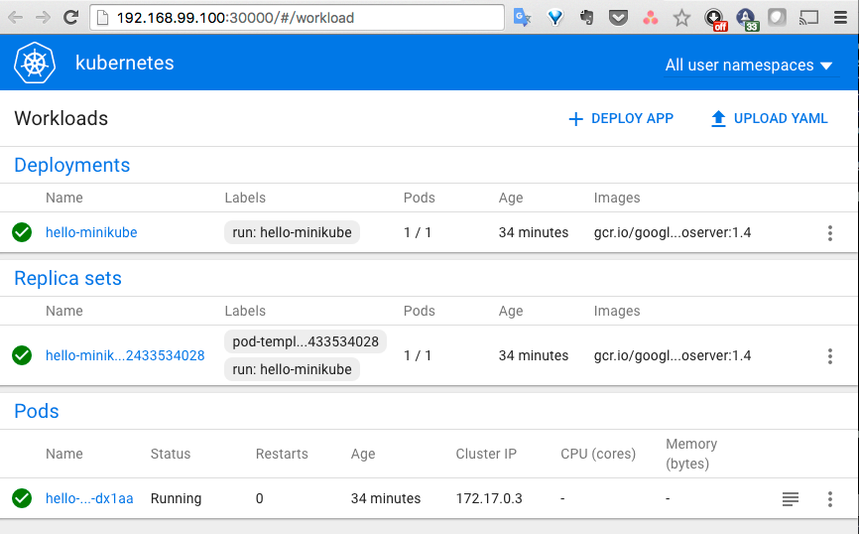
Configure Kubernetes Environment (Minikube Overview)
Minikube is a tool that makes it easy to run Kubernetes locally. Minukbe runs a single-node Kubernetes cluster in a VM on your laptop.
Simplest way to get Kubernetes cluster up and running
Supports Microsoft Windows and Mac OS X

Slide 5
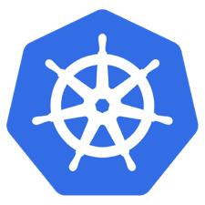
Install Docker
https://docs.sevenbridges.com/docs/install-docker
Follow the required steps for your OS
Linux
Mac OS
Windows
Docker Community Edition (CE) is ideal for developers and small teams looking to get started with Docker and experimenting with container-based apps. Docker CE has three types of update channels, stable, test, and nightly:

Slide 6
Download VirtualBox
Here you will find links to VirtualBox binaries and its source code.
https://www.virtualbox.org/wiki/Downloads
VirtualBox 5.2.18 platform packages
Windows hosts
OS X hosts
Linux distributions
Solaris hosts
The binaries are released under the terms of the GPL version 2.

Slide 7
Install kubectl binary using curl
kubectl
https://kubernetes.io/docs/tasks/tools/install-kubectl/
OSX:
curl -LO https://storage.googleapis.com/kubernetes-release/release/$(curl -s https://storage.googleapis.com/kubernetes-release/release/stable.txt)/bin/darwin/amd64/kubectl
Linux:
curl -LO https://storage.googleapis.com/kubernetes-release/release/$(curl -s https://storage.googleapis.com/kubernetes-release/release/stable.txt)/bin/linux/amd64/kubectl
Windows:
curl -LO https://storage.googleapis.com/kubernetes-release/release/v1.12.0/bin/windows/amd64/kubectl.exe
Add the kubectl.exe binary in to your PATH.

Slide 8
Running Kubernetes Locally via Minikube
kubernetes/minikube
https://github.com/kubernetes/minikube/releases
OSX:
curl -Lo minikube https://storage.googleapis.com/minikube/releases/v0.30.0/minikube-darwin-amd64 && chmod +x minikube && sudo cp minikube /usr/local/bin/ && rm minikube
Linux:
curl -Lo minikube https://storage.googleapis.com/minikube/releases/v0.30.0/minikube-linux-amd64 && chmod +x minikube && sudo cp minikube /usr/local/bin/ && rm minikube
Windows [Experimental]:
Download the minikube-windows-amd64.exe file, rename it to minikube.exe and add it to your path.

Slide 9
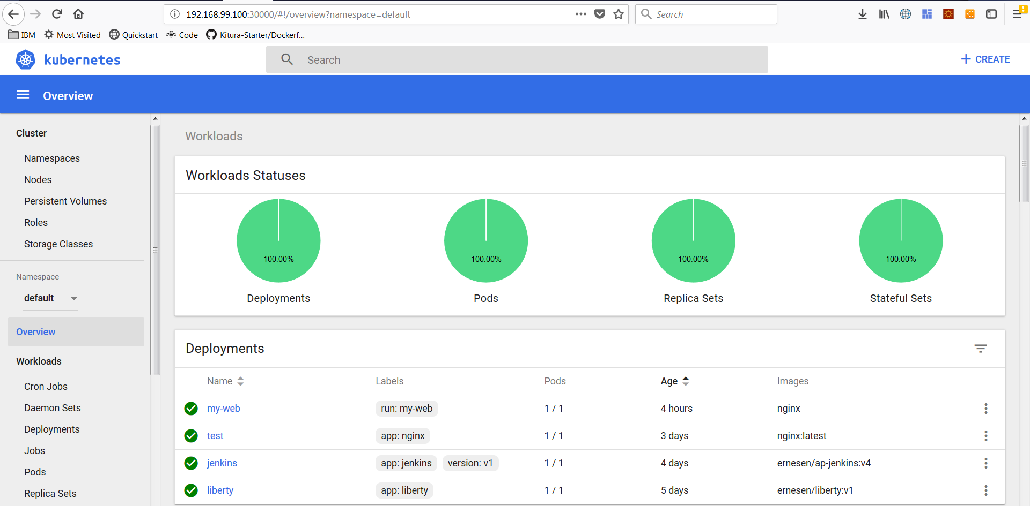
Running and accessing Minikube
$ minikube start --memory 10240 --vm-driver=virtualbox
To access dashboard issue this command:
$ minikube dashboard

Slide 10

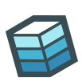

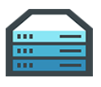













Docker Mission
Docker is an open platform for building distributed applications for developers and system administrators
Build
Ship
Run
Any App
Anywhere
10

Slide 11


Docker Components
Image
A read-only snapshot of a container stored in Docker Hub to be used as a template for building containers
Container
The standard unit in which the application service resides or transported
Docker Hub/Registry
Available in SaaS or Enterprise to deploy anywhere you choose
Stores, distributes, and shares container images
Docker Engine
A program that creates, ships, and runs application containers
Runs on any physical and virtual machine or server locally, in private or public cloud
Client communicates with Engine to execute commands
SaaS
Enterprise
11

Slide 12
The Need for container Orchestration
The unit of deployment is changing from machine to a container
Infrastructure has become immutable
Emphasis on treating the datacentre as a large server (cluster)
Tools are evolving to manage the new datacentre infrastructure
Docker Swarm
Kubernetes
Mesosphere DC/OS
Manage the lifeclycle of the containerised application running in production
Automate the distribution of application
Ensure higher levels of utilization and efficiency

Slide 13
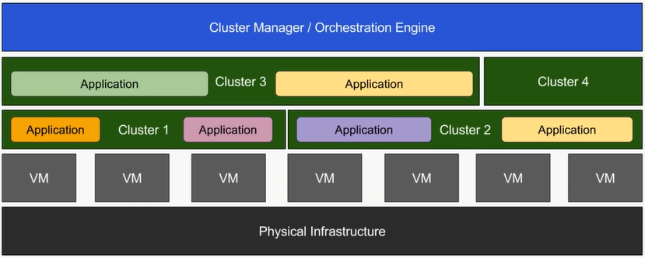
The Changing Face of the Datacentre

Slide 14
What is container orchestration?
Container orchestration
Manages the deployment, placement, and lifecycle of workload containers
Cluster management
Federates multiple hosts into one target
Scheduling
Distributes containers across nodes
Service discovery
Knows where the containers are located
Distributes client requests across the containers
Replication
Ensures the right number of nodes and containers
Health management
Replaces unhealthy containers and nodes
Container Orchestrator
Manager
Image Repository
Scheduler
Discovery DB
Replicator
Node
Node
Node
Daemon
Daemon
Daemon
Containers
Containers
Containers

Slide 15
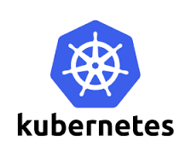

Container Orchestration in IBM Cloud
In June 2015 when IBM Container Service launched, open source orchestration projects were not available for production
Kubernetes – July 21, 2015
Docker Swarm – November 3, 2015
Apache Mesos – July 27, 2016
IBM developed custom orchestration to ensure anti co-location of containers within a group and container placement to the least utilized hosts
IBM Research runs rigorous performance and scalability testing (https://github.com/Open-I-Beam/containers-os) on various open source projects; then work with those communities to make improvements

Slide 16
Kubernetes

Slide 17
What is Kubernetes
Kubernetes is inspired from an internal Google project called Borg
Open source project managed by the Linux Foundation
Unified API for deploying web application, batch jobs and databases
Decouple applications from machines through containers
Declarative approach to deploying applications
Automates application configuration through services discovery
Maintains and tracks the global view of the cluster
APIs for deployment workflow
Rolling updates, canary deploys, and blue-green deployments

Slide 18
What is Kubernetes?
Container orchestrator
Runs and manages containers
Unified API for deploying web applications, batch jobs, and databases
Maintains and tracks the global view of the cluster
Supports multiple cloud and bare-metal environments
Manage applications, not machines
Rolling updates, canary deploys, and blue-green deployments
Designed for extensibility
Rich ecosystem of plug-ins for scheduling, storage, networking
Open source project managed by the Linux Foundation
Inspired and informed by Google's experiences and internal systems
100% open source, written in Go

Slide 19
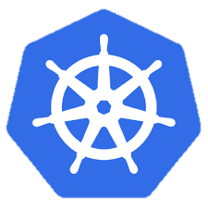
Kubernetes Architecture
internet
Master nodes
Computer with processes that manage the cluster
Multiple nodes for HA
Access mode
API
UI
CLI
Registry
Worker nodes
Computers that host pods
Pods host application containers
kubectl
firewall
Kubernetes cluster
Worker node
kube-proxy
kubelet
docker
pod
pod
pod
Master node
pod
pod
pod
cAdvisor
container
container
authentication authorization
container
container
APIs
container
scheduling
actuator
REST
Worker node
kube-proxy
controller manager
kubelet
Distributed watchable storage (etcd)
docker
pod
pod
pod
pod
pod
pod
cAdvisor
container
container
container
container
container

Slide 20
Kubernetes Terminology: Topology
Cluster
Collection of worker nodes managed by the same master node
Makes the worker nodes behave like one big computer
Master node
Controls and manages the cluster
Scheduling and replication logic
Generally two or more master nodes for resiliency, but are not used for scaling out the cluster
Worker node
Node where pods are run
Docker – Docker engine for running containers (including the kubelet)
kubelet
Kubernetes agent that accepts commands from the master
Manages pods in the node
cAdvisor – Container Advisor provides resources usage and performance statistics
kube-proxy – network proxy service responsible for routing activities for inbound or ingress traffic

Slide 21
Kubernetes Architecture
UI
Kubernetes Master
Worker Node 1
Worker Node 2
API
Worker Node 3
CLI
Worker Node n
Registry
Etcd
API Server
Controller Manager Server
Scheduler

Slide 22
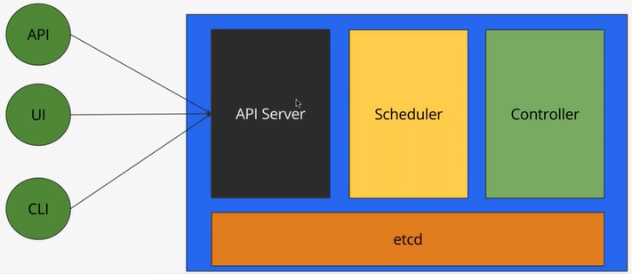
Kubernetes Master

Slide 23
Kubernetes Terminology: Master Node Components
Etcd
A highly-available key value store
All cluster data is stored here
API Server
Exposes API for managing Kubernetes
Used by kubectrl CLI
Controller manager
Daemon that runs controllers, which are the background threads that handle routine tasks in the cluster
Node Controller – Responsible for noticing and responding when nodes go down
Replication Controller – Replaced by ReplicaSet
Endpoints Controller – Populates the Endpoints object (that is, joins services and pods)
Service Account & Token Controllers – Create default accounts and API access tokens for new namespaces
Scheduler
Selects the worker node each pods runs in

Slide 24
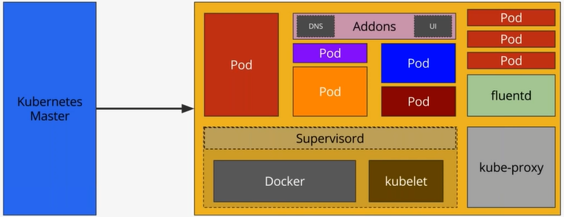
Kubernetes Node

Slide 25
Kubernetes Terminology: Node Components
Node components run on every node, maintaining running pods and providing the Kubernetes runtime environment.
kubelet
An agent that runs on each node in the cluster. It makes sure that containers are running in a pod.
The kubelet takes a set of PodSpecs that are provided through various mechanisms and ensures that the containers described in those PodSpecs are running and healthy.
kube-proxy
kube-proxy enables the Kubernetes service abstraction by maintaining network rules on the host and performing connection forwarding.
Container Runtime
The container runtime is the software that is responsible for running containers. Kubernetes supports several runtimes: Docker, rkt, runc and any OCI runtime-spec implementation.Used by kubectrl CLI
Addons
Addons are pods and services that implement cluster features. The pods may be managed by Deployments, ReplicationControllers, and so on. Namespaced addon objects are created in the kube-system namespace.

Slide 26
Kubernetes Architecture: Workloads
Kubernetes components
Container
Packaging of an app
Pod
Unit of deployment
Service
Fixed endpoint for 1+ pods
Collection of pods exposed as an endpoint
Replication Controller
Ensures availability and scalability
Master Node
Worker Node 1
Pod
Pod
App A
App B
App A Client
App A Service
Worker Node 2
Pod
Pod
App B
App A
App B Client
App B Service
Worker Node 3
Pod
Pod
App A
App B

Slide 27
Kubernetes Terminology: Workloads
Container
Unit of packaging
Pod
Smallest deployment unit in Kubernetes
A collection of containers that run on a worker node
Each pod has its own IP
A pod shares a PID namespace, network, and hostname
Service
Collection of pods exposed as an endpoint
Information stored in the Kubernetes cluster state and networking info propagated to all worker nodes
Types
ClusterIP – Exposes the service on a cluster-internal IP
NodePort – Exposes the service on each Node’s IP at a static port
LoadBalancer – Exposes the service externally using a cloud provider’s load balancer
ExternalName – Maps the service to an external name (such as foo.bar.example.com)

Slide 28
Kubernetes Terminology: Deployment
Deployment
A set of pods to be deployed together, such as an application
Declarative: Revising a Deployment creates a ReplicaSet describing the desired state
Rollout: Deployment controller changes the actual state to the desired state at a controlled rate
Rollback: Each Deployment revision can be rolled back
Scale and autoscale: A Deployment can be scaled
ReplicaSet
The next-generation ReplicationController
A set of pod templates that describe a set of pod replicas
Uses a template that describes specifically what each pod should contain
Ensures that a specified number of pod replicas are running at any given time
Deployment
create
ReplicaSet 1
Deployment
rollback
rollout
ReplicaSet 1
ReplicaSet 2
rolling update
pod
pod
pod
ReplicaSet 2
svcA
svcA
svcB
Notes:
https://kubernetes.io/docs/concepts/workloads/controllers/deployment/
https://kubernetes.io/docs/concepts/workloads/controllers/replicaset/
https://kubernetes.io/docs/user-guide/kubectl/v1.6/#rollout
https://kubernetes.io/docs/user-guide/kubectl/v1.6/#rolling-update
https://kubernetes.io/docs/concepts/cluster-administration/manage-deployment/#canary-deployments
Blue-green deployment isn’t built-in to Kubernetes (as of July 2017). Some examples others have built:
https://techbeacon.com/one-year-using-kubernetes-production-lessons-learned
http://www.devoperandi.com/kubernetes-deployment-resource-bluegreen-deploys-for-everyone/

Slide 29
Kubernetes Autoscaling
Horizontal Pod Autoscaling (HPA)
Automatically scales the number of pods in a replication controller, deployment, or replica set
Matches the observed average CPU utilization to the specified target
Fetches metrics in two different ways: direct Heapster access and REST client access
Kubernetes Heapster enables container cluster monitoring and performance analysis
Default config: query every 30 sec, maintain 10% tolerance, wait 3 min after scale-up, wait 5 min after scale-down
$ kubectl autoscale deployment <deployment-name> --cpu-percent=50 --min=1 --max=10 deployment ”<hpa-name>" autoscaled
Creates a horizontal pod autoscaler
An HPA instance
Maintains between 1 and 10 replicas of the pods controlled by the deployment
Maintains an average CPU utilization across all pods of 50%
Notes:
https://kubernetes.io/docs/tasks/run-application/horizontal-pod-autoscale/
https://kubernetes.io/docs/tasks/run-application/horizontal-pod-autoscale-walkthrough/
https://kubernetes.io/docs/user-guide/kubectl/v1.6/#autoscale
https://github.com/kubernetes/community/blob/master/contributors/design-proposals/horizontal-pod-autoscaler.md

Slide 30
Kubernetes Terminology: Naming
Name
Each resource object by type has a unique name
Namespace
Resource isolation: Each namespace is a virtual cluster within the physical cluster
Resource objects are scoped within namespaces
Low-level resources are not in namespaces: nodes, persistent volumes, and namespaces themselves
Names of resources need to be unique within a namespace, but not across namespaces
Resource quotas: Namespaces can divide cluster resources
Initial namespaces
default – The default namespace for objects with no other namespace
kube-system – The namespace for objects created by the Kubernetes system
Resource Quota
Limits resource consumption per namespace
Limit can be number of resource objects by type (pods, services, etc.)
Limit can be total amount of compute resources (CPU, memory, etc.)
Overcommit is allowed; contention is handled on a first-come, first-served basis

Slide 31
Kubernetes Configuring Resources and Containers
Label
Metadata assigned to Kubernetes resources (pods, services, etc.)
Key-value pairs for identification
Critical to Kubernetes as it relies on querying the cluster for resources that have certain labels
Selector
An expression that matches labels to identify related resources
ConfigMap
Configuration values to be used by containers in a pod
Stores configuration outside of the container image, making containers more reusable
Secrets
Sensitive info that containers need to read or consume
Encrypted in special volumes mounted automatically

Slide 32
minikube Commands
Start minikube in the right local cluster
$ eval $(minikube docker-env)
optionally start with cpu s and memory
$ minikube start --cpus=4 --memory=4096
to change the docker machine to point to the kubernetes cluster
$ eval $(minikube docker-env)
Stop minikube
$ minikube stop
Minikube status
$ minikube status
Delete minikube
$ minikube delete
Get the minikube IP
$ minikube ip
Minikube dashboard
$ kubectl dashboard
Minikube version
$ minikube version
Minikube ssh
$ minikube ssh
Modify minikube's kubernetes addons
$ minikube addons

Slide 33
docker Commands
Build an image from the Dockerfile in the current directory and tag the image
$ docker build -t ernesen/cosmos:v1 .
List all images that are locally stored with the Docker engine
$ docker images
Delete an image from the local image store
$ docker rmi ernesen/cosmos:v1
Pull an image from a registry
$ docker pull ernesen/cosmos:v1
Retag a local image with a new image name and tag
$ docker tag alpine:3.4 ernesen/cosmos:v1
Log in to a registry (the Docker Hub by default)
$ docker login ernesen
Push an image to a registry
$ docker push ernesen /cosmos:v1
Docker run example
$ docker run –d --rm –h cosmos --name –p 9443:9443 ernesen/cosmos:v1
List the running cosmos docker container:
$ docker ps | grep cosmos
Logging into the running docker image
$ docker exec –it {cosmos container} /bin/sh

Slide 34
Kubectl Commands
Get the state of your cluster
$ kubectl cluster-info
Get all the nodes of your cluster
$ kubectl get nodes -o wide
Get info about the pods of your cluster
$ kubectl get pods -o wide
Get info about the replication controllers of your cluster
$ kubectl get rc -o wide
Get info about the services of your cluster
$ kubectl get services
Get cluster status
$ kubectl get cs
Get full deployment status with watch
$ kubectl get deployments --watch
Get the IP of a Pod
$ kubectl get pod NAME_OF_POD -template={{.status.podIP}}
Delete a Pod
$ kubectl delete pod NAME
Delete a Service
$ kubectl delete service NAME_OF_SERVICE
Use context
$ kubectl use-context minikube

Slide 35
Demo

Slide 36
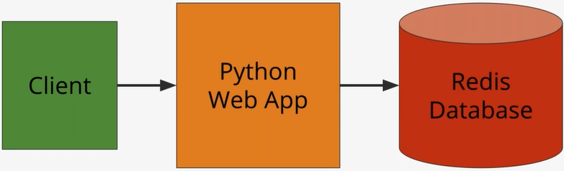
Simple Web App Demo with python

Slide 37
Kubernetes Pod
Group of one or more containers that are always co-located co-scheduled, and run in a shared context
Containers in the same pod have the same hostname
Each pod is isolated by
Process ID (PID) namespace
Network namespace
Interprocess Communication (IPC) namespace
Unix Time Sharing (UTS) namespace
Alternative to a VM with multiple processes

Slide 38
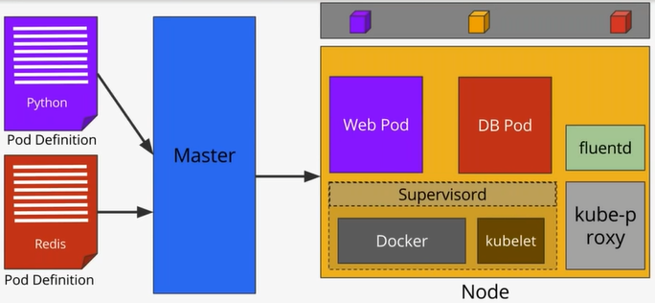
Simple Web App Demo with python

Slide 39
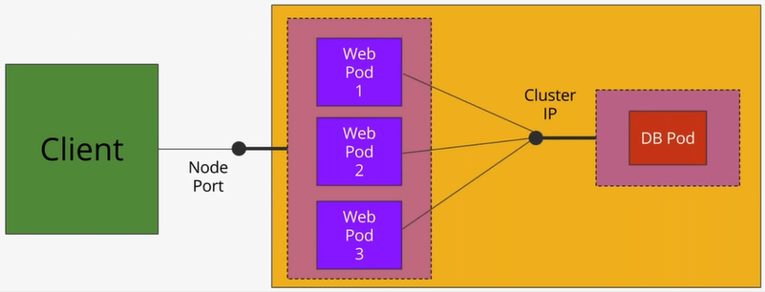
Simple Web App Demo with python

Slide 40
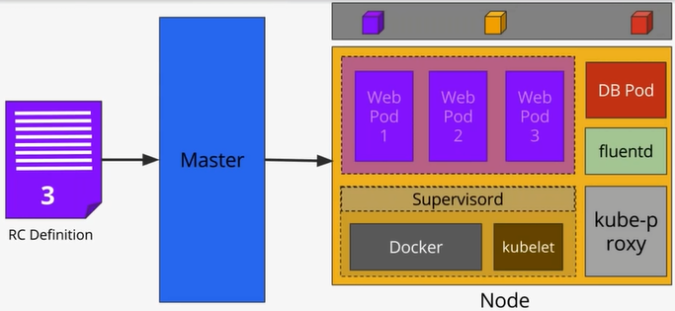
Simple Web App Demo with python

Slide 41
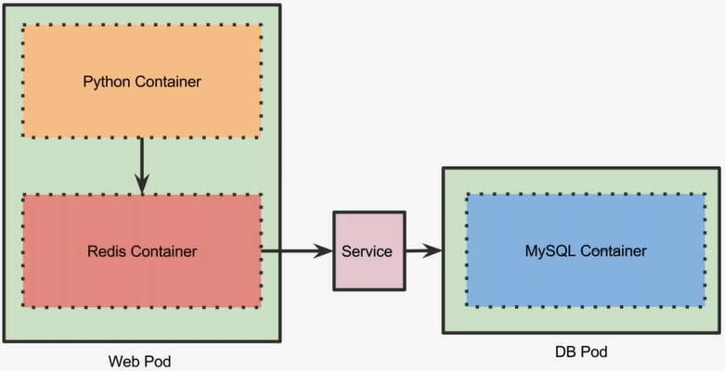
Simple Web App Demo with python, Redis and MySQL

Slide 42
Summary
Setting up your Minikube environment
Kubernetes Architecture/ICP
A closer look at Kubernetes cluster
Master components
Node components
Pods
Labels & Selectors
Replication Controllers
Services
Kubernetes/ICP A Closer Look at Pods and Replicas
Understand the concept of Pods
Explore multi-container Pods
Closer look at the use cases and scenarios for multi-container pods
Scaling Pods through Replica Sets

